Slide 1
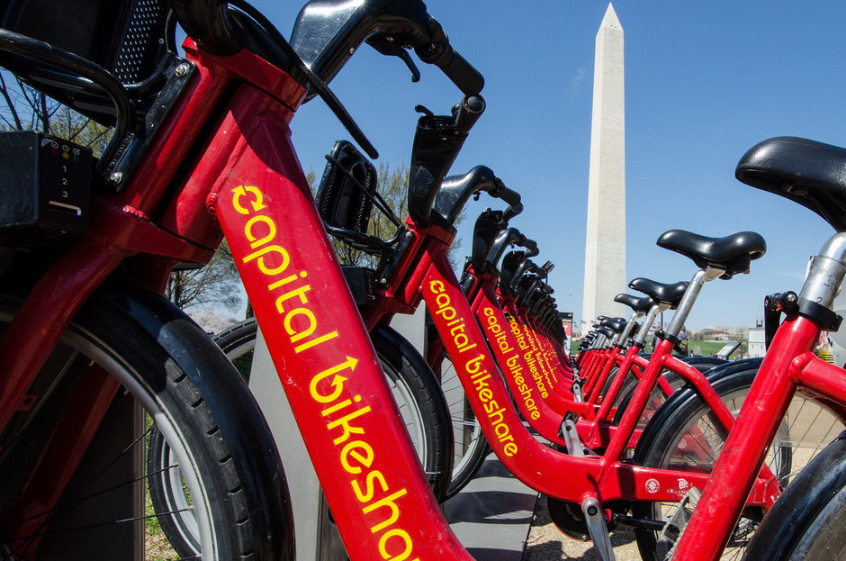
Regression Modelling
Bike Sharing

Slide 2
Context
Dataset about bike sharing in Washington D.C
Contains an hourly bike count for each day between January 2011 and January 2012
17.379 rows
17 columns

Slide 3
Column analysis
instant: record index
dteday : date
season : season (1:Winter, 2:Spring, 3:Summer, 4:Autumn)
yr : year (0: 2011, 1:2012)
mnth : month ( 1 to 12)
hr : hour (0 to 23)
holiday : weather day is holiday or not (extracted from http://dchr.dc.gov/page/holiday-schedule)
weekday : day of the week
workingday : if day is neither weekend nor holiday is 1, otherwise is 0
weathersit :
Clear, Few clouds, Partly cloudy, Partly cloudy
Mist + Cloudy, Mist + Broken clouds, Mist + Few clouds, Mist
Light Snow, Light Rain + Thunderstorm + Scattered clouds, Light Rain + Scattered clouds
Heavy Rain + Ice Pallets + Thunderstorm + Mist, Snow + Fog
temp : Normalized temperature in Celsius. The values are divided to 41 (max)
atemp: Normalized feeling temperature in Celsius. The values are divided to 50 (max)
hum: Normalized humidity. The values are divided to 100 (max)
windspeed: Normalized wind speed. The values are divided to 67 (max)
casual: count of casual users
registered: count of registered users
cnt: count of total rental bikes including both casual and registered

Slide 4
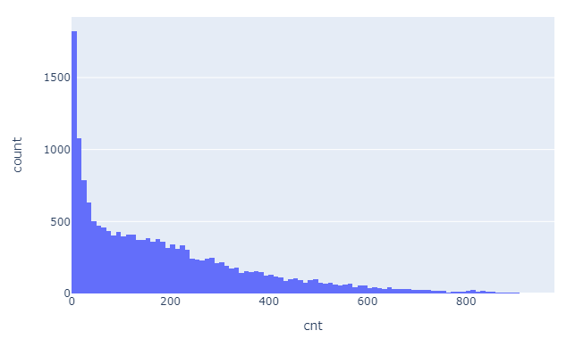
Visualizing the data
Notes:
Highest point: Between 0 and 9 bikes.
This group accounts for 1825 data points. This means that, in the majority of the hours between 2011 and 2012, you had between 0 and 9 bikes being used.

Slide 5
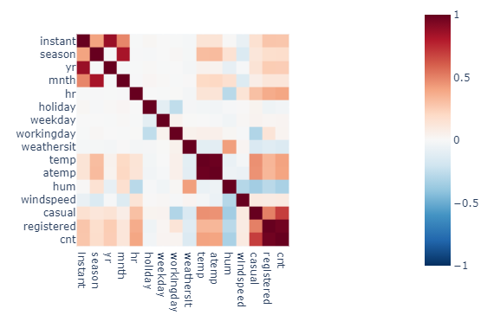
Visualizing the data

Slide 6
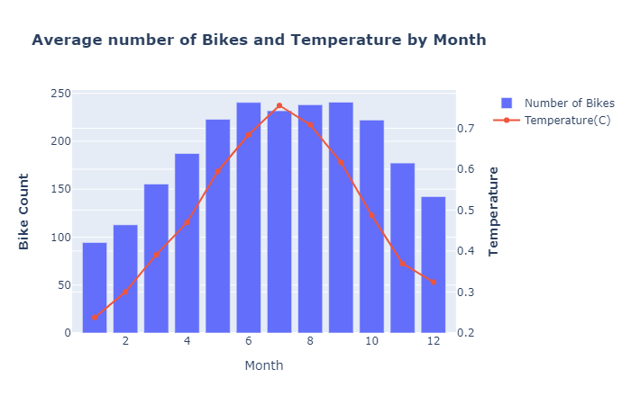
Visualizing the data

Slide 7
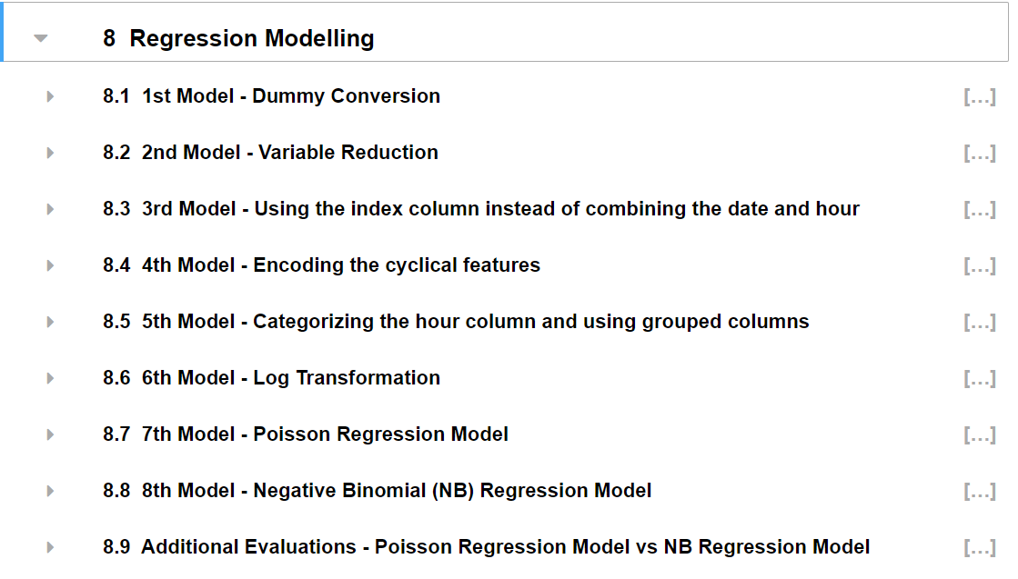
Regression Modelling

Slide 8
What I learned
Plot with Plotly
Poisson and NB Regression Models
Patsy
Time series datasets require a different approach
There is always a better model out there to discover

Slide 9
What i would have done differently
Use the day dataset
Do more visualizations to understand the correlation between the variables

